Slide 1
The role of communicative pressures in shaping the lexicon
Molly Lewis
Stanford University
EvoLang
15 December 2015

Slide 2
Notes:
a foundational assumption of linguistics (going back to saussure)…is that the linguistic sign is arbirary
That is, that there is no motivated relationship between linguistic form and meaning
This is obvious when you observe nearly an word in any language
for example in the case of the word “horse” there is nothing “horse like” about the word hor
Further evidence for the arbitrariness of the linguist sign comes from observerie the large variability in forms for the meaning “horse” across langauges
However -- while there is certainly some degree of arbitrariness in language -- there is a growing body of evidence that there are limits to this arbitrariness
- There’s evidence that certain phonomees are biased to map to certain features
- And even, that there’s phonological similiairty between words of the same grammatical class, within a language
TODAY, I’m going to desribe a previously undesribed constraint on arbitrariness in language

Slide 3


Complexity Bias
A bias to map longer words (in terms of phonemes, morphemes, syllables) to more complex referents
tupabugorn
Notes:
-In the talk today, I’ll explore a previously described constraint on arbitrarinessse in language: A complexity bias
-so, for example, imagine you saw these two objects here
- the hypothesis is that this relatively long word should be associated with a relatively more complexit referent
--------
Today, I’ll present evidence exploring this regulairity, and explore a possible communicative explanation.

Slide 4
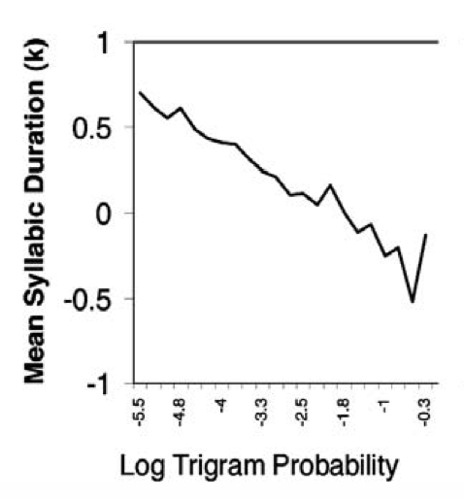
Complexity Bias
Theories of communication predict tradeoff between length and predictability
I turned on the car.
Horn Implicatures
(Horn, 1984)
TYPICAL
I got the car to turn on.
ATYPICAL
Uniform Information Density
(Aylett & Turk, 2004; A. Frank & Jaeger, 2008)
Notes:
While this hypothesis as not been directly explored at the level of the lexicon…. AT THE MOMENT OF LANGUAGE USE
On such theory is Horn’s theory of communication, in what have been called “Horn implicatures”
So, consider the sentences….both of these have the same denotational value (they refer to the sucessful starting of a car), but one is longer
The suggestion is that these two sentences differ in their USAGE (typical more predictable vs. atyipcal, perhaps where the battery was almost dead)
Similary, a UID theory of communication also predicts this tradeoff – where the proposal here is that the speakers tries to keep the amount of information constant across the speech stream, causing unpredicable meanings to be lengthened
So, here’s a plotting showing an inverse relationship between the predictableity of a syllable and it’s length in production
-- costlier less frequeint
* semantic markedness
THERES EVIDENCE
ONE EXAMPLES…..WHERE YOU CAN MAKE A a prior arguments about the relative complexity of different meanings
AND TODAY, I’m going to explore the most general prediction of this principle
Ill START by asking
negation: give some specfic
this idea of a complexity bias
in particular that meanings that are less predictable in context should be longer than more predictable meanings
a priori arguments about the relative complexities of different concepts
-
Can be interpreted as complexity sometimes? (e.g. negation case) but also circular without external metrics

Slide 5
Outline
Study 1:
Do speakers have a productive complexity bias?
Is there a complexity bias in the lexicon?
Where does the lexical bias come from?
Study 2:
Study 3:
Notes:
-- Today, I will examine the complexity hypothesis by first asking whether or not there’s evidence for it in the lexicon (in English and x –linguistically)
Then, given evidenec for this bias in the lexicon, I’ll examine whether or not it’s productive (across a range of stimuli)
Third, I’ll try to address a little more directly what exactly the nature of this complexity construct is
And, finally, I’ll consider a hypothesis about this origins of this lexical bias
---

Slide 6
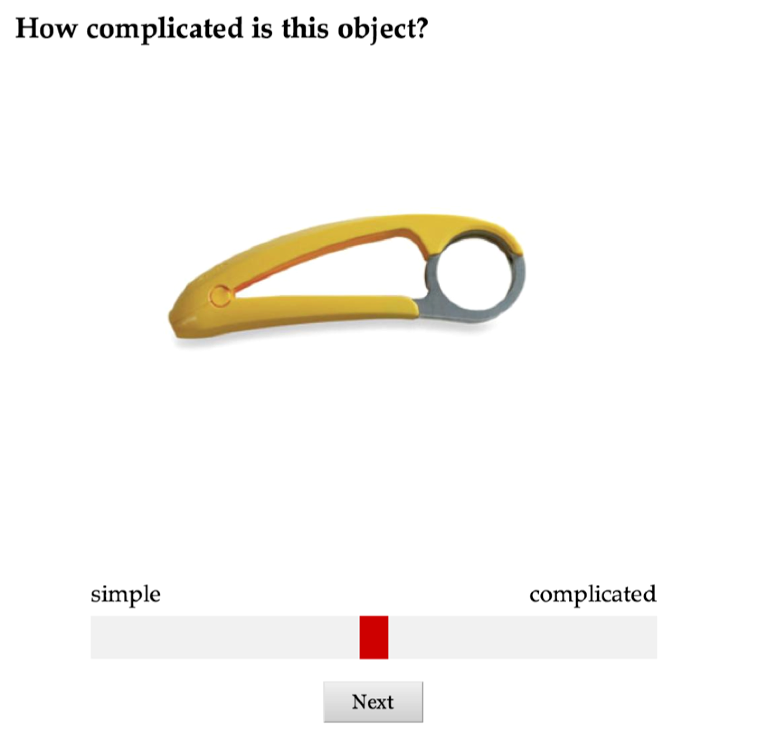
Study 1a: Explicit complexity judgment
Notes:
As a first step in testing the compexity bias
The task was very simple – we presnenct subjects with an object asked them to rate how complicated the object was, using a slider scale
-- 60 objects
10 objects per subject
** Turk

Slide 7
Least complex
Most complex
N=60
Notes:
this yielded an ordering of the objects in terms of complexity.
Here area all 60 objects sorted from least complex to most complex
A second sample of 60 participants gave ratings that were highly correlated with those of the first sample,
realiabilit of .94

Slide 8
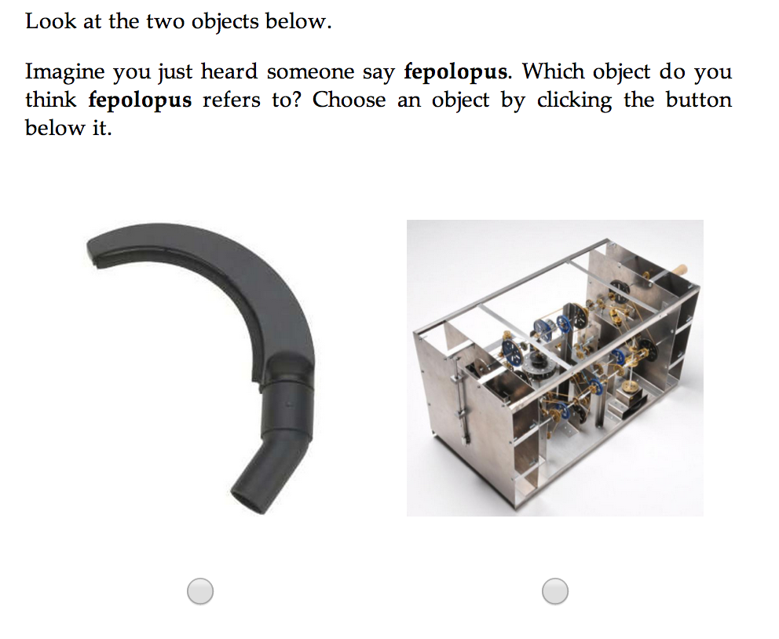
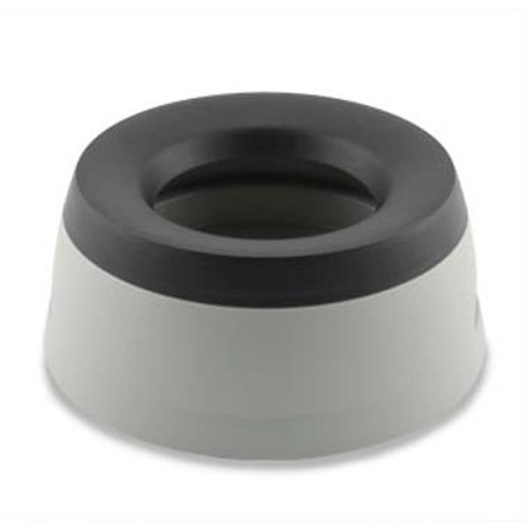

Study 1b: Mapping task
Map novel word to novel object, given 2 alternatives
Notes:
We next presented subjects with a simple mapping task
we presented the with a novel word, and their task was simply to guess the meaning of that word given two of our objects

Slide 9
Study 1b: Design
Referent complexity x word length (within subject)
Linguistic stimuli:
short words (e.g., "bugorn,” "ratum,” "lopus”)
long words (e.g., "tupabugorn,” "gaburatum,” "fepolopus")
Referent stimuli:
Divided objects into quintiles, based on explicit complexity norms
Tested every pairing of quintiles (15 conditions): 1/1, 1/2, 1/3, 1/4, 1/5, 2/2, 2/3, etc.
Procedure: 8 trials/participant
Notes:
we manipulated both…
the short words were 2 syl, and the long words were 4 syllabes

Slide 10
1
2
3
Quintile
4
5
Example 1/5 Trial
Notes:
here are the 60 objects divided in 5 quintiesl
So, for example, in 1/5, we would randomly select and object from the 1st qunitile, and from the 5th quintile, and those would be the two alternative in the FC task

Slide 11
Study 1b: Results
Target biased to have long label
Target less complex
N = 1500
Notes:
Here are the results from 1500 participants,
I’m going to plot each of the 15 pairings of quintiles as a point
On the y axis, I’m plotting the effect size between the long and short words conditions
And, on the x axis I’m plotting the ratio of the complexity ratings between the two alternatives
Points higher on the y axis indicate a bias to have a long label
And, points farther to the right on the x axis indicate that the target is lessRELATIVELY complex
And here are the data: we see the predicted tradeoff between complexity and length, such that RELATIVELY more complex objects were more likely to be assigned a long label
CORR +

Slide 12
Is this bias in natural language?
Exp. 1-2: suggest a productive complexity bias with novel words
Exp. 3: Complexity bias related to processing time.
Next: Is this bias present in natural languages?
Study 4: Explicit complexity norms for English words
Notes:
Expected if due to, if this bias is due to
So, in study 3, we generated novel meaning, by having subject norm the complexity of novel objects

Slide 13
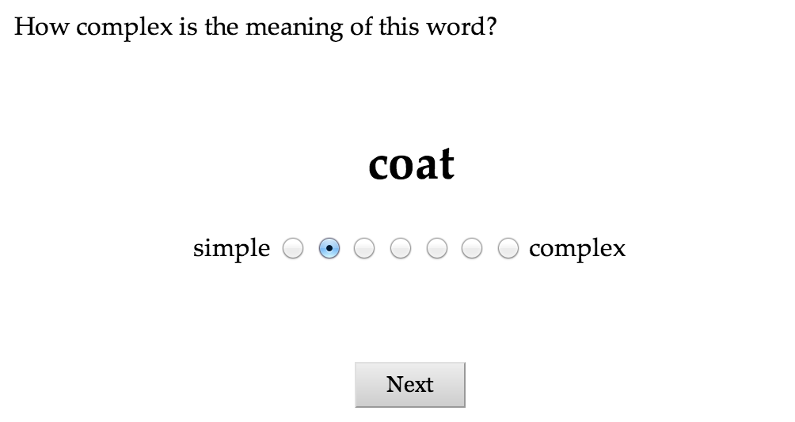
Study 2a: English complexity norms
Rate words for complexity
alphabet
Notes:
we normed a set of words for their semantic complexity
Participants were presented with a word, and they simply had to rate on a 7 pt likert scale how complex the meaning of the word is

Slide 14
Complexity norms
Normed 499 English words
30 words/participant
N = 250 participants
Notes:
..of varying length (here’s a histogram of the words by their length)
Note that I’m counting word length in terms of characters here and throughout the talk, only because it’s easy to measure
but, all of the relationship I’ll be talking about hold for for psychologically real measures of length (like phonemes and syllables)

Slide 15
Study 2a: Results
Characters:
r_{CL •F} = .60
Phonemes:
r_{CL} = .69
r_{CL •F} = .61
Syllables:
r_{CL} = .67
r_{CL •F} = .58
Reliable controlling for
concreteness, familiarity
and imagability
N = 250
Notes:
- I’m going to plot a point for each word, where the x dimension indcates ites length in characters and the y dimension corresponds to the mean complexity rating for that word
a strong postive correlation between length and complexity judgements, such that are more complex tend to have longer words associated withm
complex words tend to be longer
Of course an additional correlate of word length is frequency, and so we also examined the relationship between complexity and length partialing out the effect of LOG FREQUENCY
this relationship is even stronger when you measure length in terms of phonemes and syllabes.
And, critically, this relationship holds, even controling for other semantic variables like concreteness, familiartiy and imegeability
LOG frequency
phonemes characters = .87
syllables characters = .93
HOLDS CONTROLING FOR THINGS
complexity with complexity
concreteness –to experience with senses
imagebaiilty - evoke a sensory experience, conjure a mental image t

Slide 16
Study 2b: Cross-linguistic
Evidence that complexity is related to length in English (controlling for other semantic variables)
But: does this extend to other languages?
Examined relationship between word lengths for normed words in 80 languages
Google translate
Native speakers hand-checked 12 languages
Accuracy: 92%
Notes:
* process of checking
translation for you. By detecting patterns in documents that have already been translated by human translators, Google Translate can make intelligent guesses as to what an appropriate translation should be.
This process of seeking patterns in large amounts of text is called "statistical machine translation".

Slide 17
Correlation between complexity norm and word length
# open class words = 453
Notes:
Alright, so I’m going to plot here the correlation between complexity norm and word length for each of the 80 languages we examined
I’m only going to show here the results only the open class items, which I think is a more conservative test of our hypothesis
the y axis is the magniutd of the peason’s r, and each bar correspond to a language
here are the correlatinons between word length and cmplexity first, for the 12 hand checked languages
And, here they are for the full set
the thing to notice here, is that they are all positive with a mean of .3 (.22 controling for frequency)
A secondary prediction is that words across languages should be corelatied with eachother, and we find this is true with a correlation of about .3 (?)
correlation of lengths = about .3 (.22 controling for frequency)

Slide 18
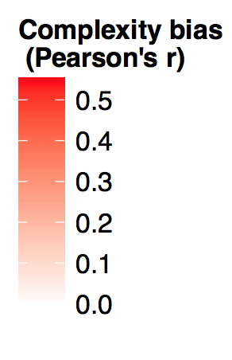
Geographical distribution of complexity bias

Slide 19
Complexity bias by language family
Notes:
Bias is reliably, controling for language family

Slide 20
What accounts for this variability?
Differences in cross-linguistic pressures at the in-the-moment timescale
…leads to adaption over the language evolution timescale. (Linguistic Niche Hypothesis; Lupyan & Dale, 2010)
t
In-the-moment timescale (minutes)
Language change
timescale (many years)
Notes:
* process of checking
translation for you. By detecting patterns in documents that have already been translated by human translators, Google Translate can make intelligent guesses as to what an appropriate translation should be.
This process of seeking patterns in large amounts of text is called "statistical machine translation".

Slide 21
Linguistic Niche Hypothesis
What in-the-moment pressures might vary cross-linguistically? (Nettle, 2012)
# of non-native learners
input variability (~size of community)
climate
Evidence for relationship between these pressures and features of language at many levels of linguistic structure (Atkinson, 2011; Hay & Bauer, 2007; Wichmann, Rama, & Holman, 2011; Bentz, Verkerk, Kiela, Hill, & Buttery, 2015; Lupyan & Dale, 2010; Bentz & Winter, 2013).
Notes:
Less variable (few people, or less variable people; more homoegeneous social network)
rate of drift (~size of community, faster in small)
,

Slide 22
Testing the Linguistic Niche Hypothesis
E.g., Languages with bigger populations have more consonants?
Bauer & Hay (2007)
Donohue & Nichols (2011)
Many conflicting findings in the literature, and different methods
Aggregating across datasets that have explored the Linguistic Niche Hypothesis, using same analytical techniques
Notes:
5 datasets
Less variable (few people, or less variable people; more homoegeneous social network)
rate of drift (~size of community, faster in small)
,

Slide 23
Study 6
Demographic and geographic features:
Total population (Lupyan & Dale, 2010)
Number of neighboring languages (Lupyan & Dale, 2010)
Area of region (Lupyan & Dale, 2010)
Mean and SD of temperature (Lupyan & Dale, 2010)
Mean and SD of precipitation (Lupyan & Dale, 2010)
# of L2 speakers (Bentz, et al. 2015)
Linguistic features:
Morphological complexity (Lupyan & Dale)
Complexity bias (Lewis & Frank, 2014)
Lexical diversity (Bentz, et al. 2015)
Word length (Wichmann, Rama, & Holman, 2014)
# of vowels and consonants (Moran, McCloy & Wright, 2012)
Number of languages: M = 1500, range: 79 - 4421
(Lewis & Frank; under review)
Notes:
5 datasets
Less variable (few people, or less variable people; more homoegeneous social network)
rate of drift (~size of community, faster in small)
Lupyan and Dale (2010). This dataset contains grammatical information from WALS (Dryer & Haspelmath, 2013), and demographic and geographic information from Ethnologue and the Global Mapping Institute (Gordon, 2005). The demo- graphic and geographic variables included total population of speakers, number of neighboring languages, area of region in which the language is spoken (km2), mean and standard deviation temperature (celsius), and mean and standard devi- ation precipitation (cm). We used these data to create a met- ric of morphosyntactic complexity calculated from 27 of the 28 morphosyntactic variables analyzed in the original paper.1 For each variable, we coded the strategy as simple if it relied on a lexical strategy or few grammatical distinctions (e.g., 0- 3 noun cases), and complex if it relied on a morphological strategy or many grammatical distinctions (e.g., more than 3 noun cases). We summed the number of complex strategies to derive a measure of morphosyntactic complexity for each language, including only languages with data for all 27 vari- ables. [n = 1991 languages]
Bentz et al. (2015). Two variables were used from this dataset: ratio of L2 to L1 speakers and number of word forms. Estimates of number of word forms were taken from transla- tions of the Universal Declaration of Human Rights. Num- ber of word forms was calculated as the number of unique words divided by the number of total words (type-token ra- tio). Higher type-token ratio indicates more word types in that language. Speaker population data were taken from a va- riety of sources, where L2 speakers were restricted to adult non-native speakers only. [n = 81]
Moran, McCloy and Wright (2012). Estimates of number of consonants and vowels in each language were used from this dataset. [n = 969]
Lewis and Frank (2014). This work finds that languages tend to map more complex meanings (measured via semantic norms) to longer words. The bias is estimated as the cor- relation (Pearson’s r) between word length and complexity ratings for a set of 499 words translated via Google Trans- late. We used estimates of the correlation that partialed out the effect of spoken frequency. [n = 79]
Wichmann, Rama, and Holman (2014). This database con- tains translations for 40-lexical items across many languages. Word length was calculated as the mean number of characters in the ASJPcode transcription system across words in each language. [n = 4421]
Aggregating across datasets, we analyzed 8 environmen- tal variables in total: L2-L1 population ratio, total population size, number of neighbors, area of spoken region, mean and standard deviation temperature, and mean and standard de-
,

Slide 24
Method
Tested for linear relationship between each linguistic variable and demographic/geographic variable
A challenge: non-independence
Genetic relatedness
Language contact
One solution: Mixed-effect models (Jaeger et al., 2011)
language.var ∼ environmental.var +
(environmental.var | language.family) +
(environmental.var | origin.country)
Notes:
n the main analysis, we fit mixed effect models predicting each language variable with each environmental variable us- ing areal controls. The results are presented in Figure 2. For each language variable, there was at least one environmen- tal variable that reliably covaried, though some previously- reported effects were not significant in this analysis. We re- turn to this in the discussion. Data can be explored interac- tively here: https://mlewis.shinyapps.io/lhnn/.

Slide 25
https://mlewis.shinyapps.io/lhnn/
Notes:
https://mlewis.shinyapps.io/lhnn/.

Slide 26
Discussion
Uniform analysis of the Linguistic Niche Hypothesis
But: large number of variables make it difficult to distill coherent picture
Many variables correlated with each other
Used principle component analysis to reduce dimensionality, then fit same model as before
Notes:
Technique for dimensionality reduction
We found the principal components associated with the variance for the en- vironmental variables and the linguistic variables, and then fit the same model as in the primary analysis using the rotated values. Complexity bias was excluded because it was only available for a small subset of languages. All variables were scaled.

Slide 27
Languages in cold, small communities are more complex.
Notes:
First two principle 70 % of the varaince

Slide 28
Discussion
More complex languages are spoken in small, cold regions.
across a range of linguistic features using the same analytic technique across all measures
Why small?
Larger places have more second-language learners
Second-language learners bad at acquiring complexity
Languages adapt by simplifying
Why cold?
Maybe speakers in colder regions are less itinerant
Less contact with adult speakers of other languages?
Notes:
features—morphosyntactic complexity, linguistic diversity, word length, and consonant inventory—

Slide 29
Conclusion
Complexity bias as a case study in regularity
Individuals have a bias to map long words onto more complex meanings
Complexity grounded in basic cognitive process, but still an open question
Use our understanding of cognitive processes to understand variation in macro regularities of social structure
Learning pressures shape language regularities
Notes:
Expected if due to, if this bias is due to
So, in study 3, we generated novel meaning, by having subject norm the complexity of novel objects

Slide 30
Thank you
Notes:
ideas:- measure length->complexity inference by asking about complexity of known words- have pariticpants rate meaning of mahowald pairs- audio version where vary sound of word- hold complexity constant, by using different birds, learn different words- vary complexity of context -> does that affect length? (emmanuel, preposositions)- look at reaction time in learning task -> do participants study longer when mismatch? I could maybe do this analysis.- maybe look at change relative to previous generation?

Slide 31
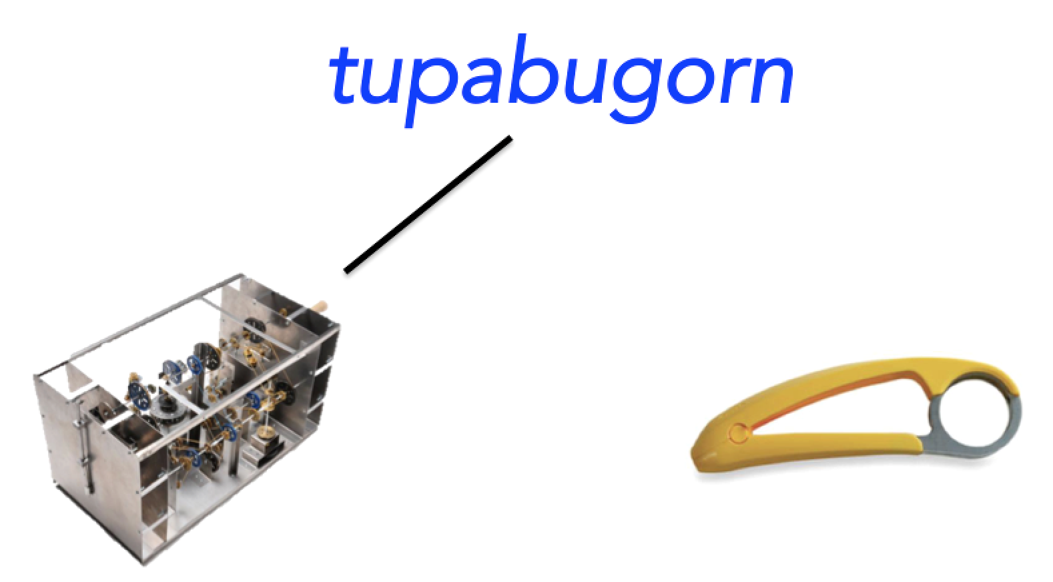
Where does the bias in language come from?
Productive complexity bias
Lexical complexity bias
Complexity bias in individual speakers over time leads to the same regularity emerging in the structure of the lexicon
Notes:
Taken together the current set of studies point to a productive complexity bias in individual speakers
And, we also have evidence – across a range of languages – that this bias is instantiated in the structure of the lexicon
But, as it stands, we don’t have any evidence that speaks to a possible relationship between these two data points
The hypothesis that we’re currently pursiueing is that there’s a causal relationship between these two phenomenon
In particular
Cognitive Hypothesis: pressure in individual speakers to map longer words onto more complex meanings
communicative bias?
iconicity bias?
other?
** bias to remember the labels this way

Slide 32
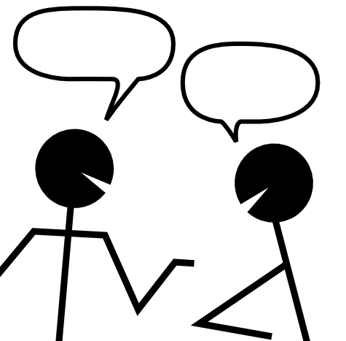
Where does the bias in language come from?
A mechanism over multiple timescales
t
Conversational timescale (minutes)
Language change
timescale (many years)
^{(Griffiths & Kalish, 2007)}
Notes:
- This phenonmenon, however, is difficult to test,
in part because it RELIESon phenomenon that occor over multiple timescleas
the idea that in the momement of language the psychologial complexity bias leads to small errors in memory for words
Then, over the course of langauge evolution, these small errors become magnificed and eventually instaniated in the struccture of the lexicon
And this happens over the course of moments in a conversation
The proposed mechanism for this IS that a psychological bias causes small changes in memory for complex phonological and over time these memory biases get magnified an instantiated in the leixcon

Slide 33
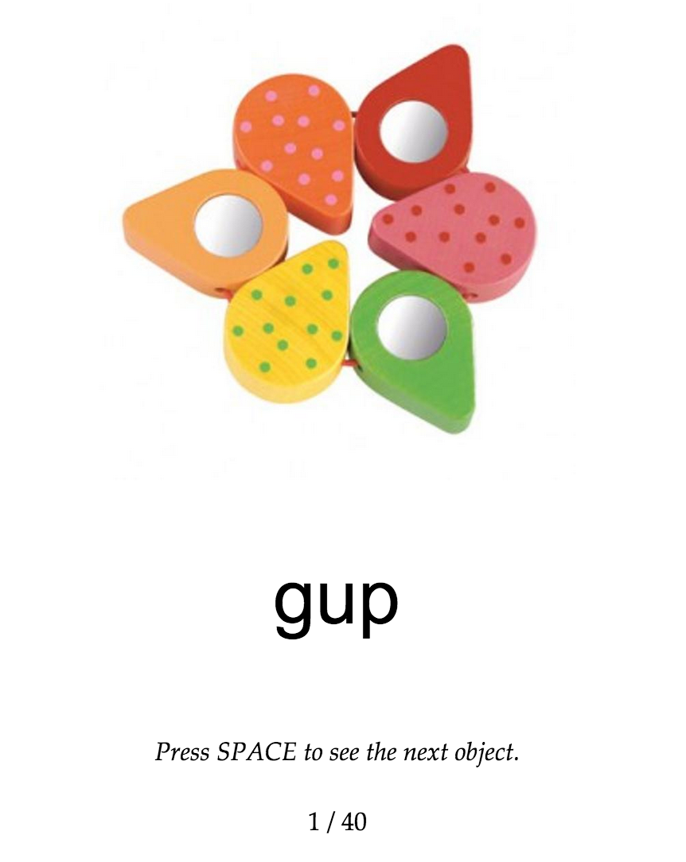

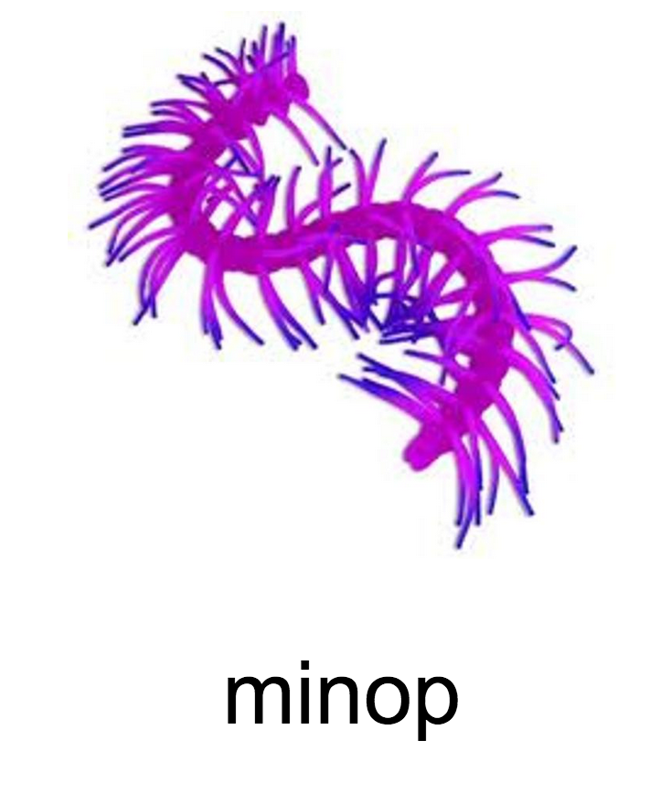
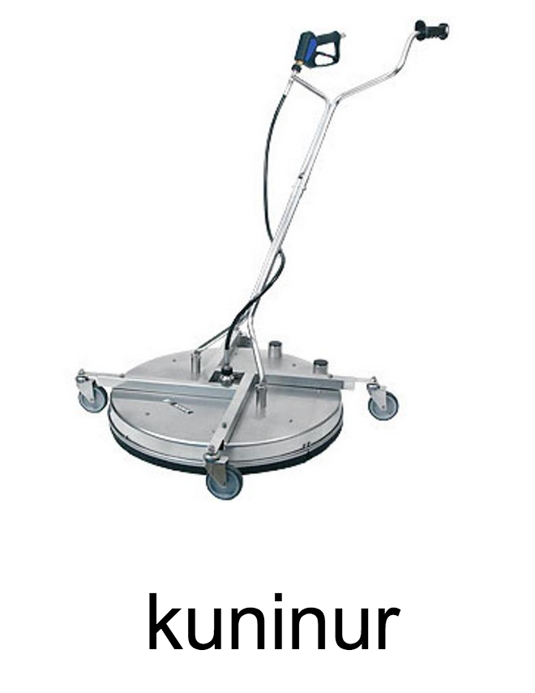
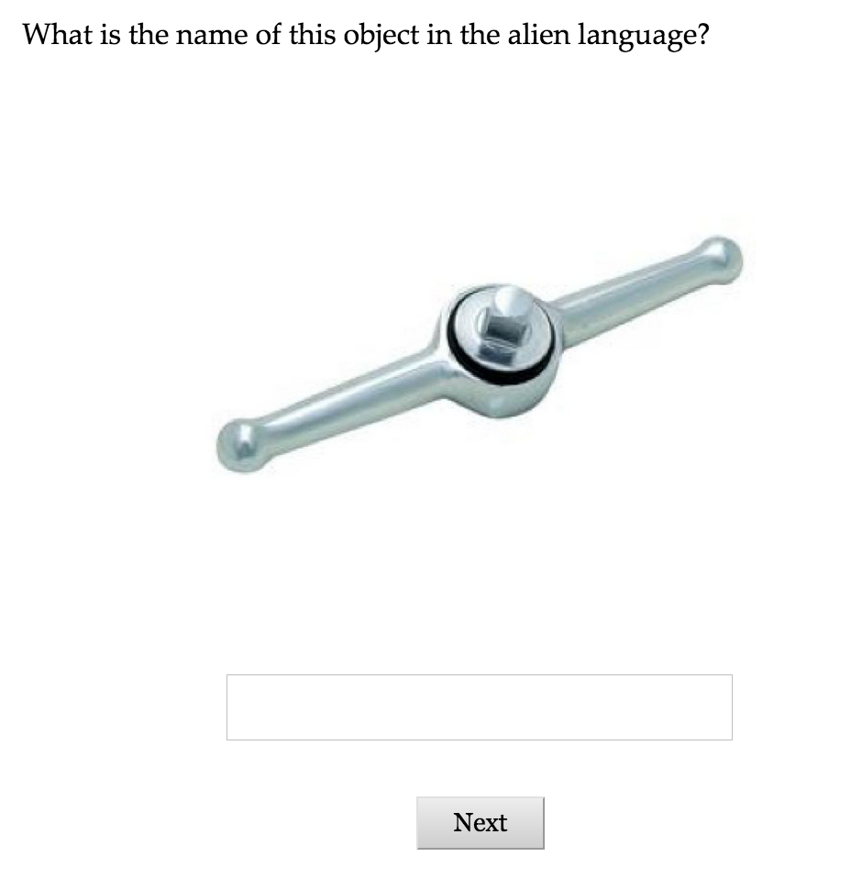

Study 6: Lexical learning
Word learning
Word recall
(10 word-object pairs x4)
Notes:
As a first step in testing this proposal, we ran an lexical learning task where we could examine memor erros
----
CRITICALLY, their viewing of these objects during the training phase was self-paced
which allowed us to measure….

Slide 34
Study 6a: Lexical learning
Generated random lexicon
Words: 3, 5, 7, 9, 11 characters (CV syllables)
Objects: 2 from each complexity quintile
Predictions:
Word forms: Become more stable
Complexity bias: Shorten words for simple objects, lengthen words for complex objects
ninop
nin
ninop
ninopen
Notes:
And the lexicon that the learned…
Where, critically, the mapping between word lenghts and objects was randome
We had two general predictions – we expected word forms themsleves to change from input forms to the forms participants recalled
perhaps shorter and easier to remebr

Slide 35
Study 6a: Results Words are shortened for simple objects
Shorter words
Complexity
N = 50
Notes:
And, what we found was that participants tended to shortner words for simple objects
That is, Replicate complexity bias in learning paradigm

Slide 36
Study 6b: Iterated lexical learning
Iterated learning paradigm – a method for simulating language change
Gave the labels generated by participants to a new set of participants
Iterated for total of 7 generations
50 participants/generation
Notes:
- But what we’re really intereested in is how this memory bias influences the language over time
To address this question, we made use of the iterated learning paradigm
The idea of this paradigm is that the learning output of one learner become the learning input for the next learner
Which provides a method for simulating the dynamics of language change in the lab

Slide 37
Study 6b: Iterated lexical learning Word forms become more stable
Across generations, words tended to:
become easier to remember
shorten
increase in bigram transitional probability
decrease in variability
decrease in word change (Levenshtein edit distance)

Slide 38
Study 6b: Iterated lexical learning Complexity bias persists across time
Shorter words
complexity
Notes:
- We next looked at the mappings between words and meanings
here are the data from the first generation that I showered you earlier -- labels for more complex objects are shortened less
and what we find is that the effect persists across generations, but doesn’t seem to strength as we might have expected
(despite changes)

Slide 39
But, why doesn’t it strengthen?
Pressure to simplify suppresses complexity bias
Two competing communicative pressures (Horn, 1984):
Speaker/learner pressure → compression
Listener pressure → differentiation
Task not communicative
Presence of a listener pressure reduces compression?
Currently running version with interlocutor, and version with binary feedback
Notes:
Why it doesn’t seem to strength is somewhat puzzling
one possible explanation is that the pressure to simplify the words supproessed the effect
this might differ from actual language use because our task wasn’t communicative
that is, because tehre was no communciative pressure with there was a pressure to change all these words into short, non-unique forms
And so, a communication version of this task might facilitate the effect
Chains that show a greater change over time also show a greater incrrease in the complexity bias
A second possibility is that this effect is deeply related to memory limitations
That is the degree to which we see this effect emerge should be related to how much change there is in the system
*** Currently running version with communicator

Slide 40
Conclusion
Evidence for:
a complexity bias in the lexicon
productive
related to a basic cognitive process
can emerge from learning biases
Suggests:
complexity as constraint on arbitrariness in language
cognitive biases are reflected in the structure of the lexicon
communicative biases may shape the lexicon
Notes:
First analysis of the relationship between utterance length and referent complexity at the level of words.
- in work I didn’t talke about today, we’ve also found this =bias in preschooelrs
BUT: number of hypothesis consitent with our data
also present in 3-5 yo
.. which suggests that communicative pressures may potentially play a role in shaping the structure of the lexicon
across different stimuli
also, present in preschoolers

Slide 41
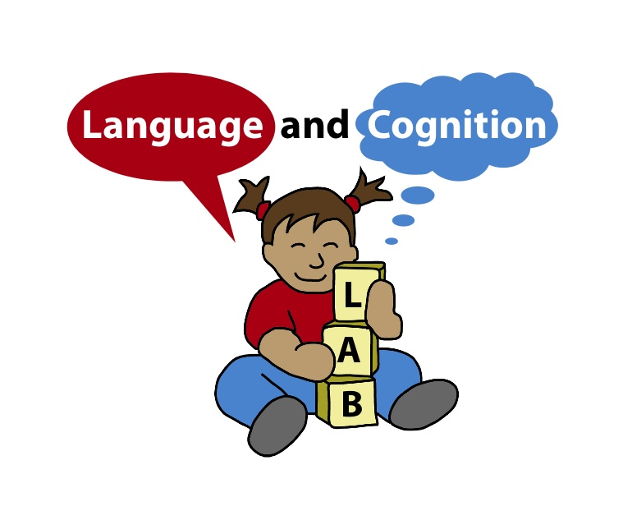
Thank you
Notes:
ideas:- measure length->complexity inference by asking about complexity of known words- have pariticpants rate meaning of mahowald pairs- audio version where vary sound of word- hold complexity constant, by using different birds, learn different words- vary complexity of context -> does that affect length? (emmanuel, preposositions)- look at reaction time in learning task -> do participants study longer when mismatch? I could maybe do this analysis.- maybe look at change relative to previous generation?

